Slide 1
Structured Data struct

Slide 2
Abstract Data Types
A data type that specifies
values that can be stored
operations that can be done on the values
User of an abstract data type does not need to know the implementation of the data type, e.g., how the data is stored
ADTs are created by programmers

Slide 3
Abstraction and Data Types
Abstraction: a definition that captures general characteristics without details
Ex: An abstract triangle is a 3-sided polygon. A specific triangle may be scalene, isosceles, or equilateral
Data Type defines the values that can be stored in a variable and the operations that can be performed on it

Slide 4
struct (Structure)
Your first custom data type
You define & build it
This C struct is a step towards an ADT (Abstract Data Type)

Slide 5
Combining Data into Structures
Structure: C++ construct that allows multiple variables to be grouped together
General Format:
struct <structName>
{
type1 field1; // called members
type2 field2; // or fields
. . .
};

Slide 6
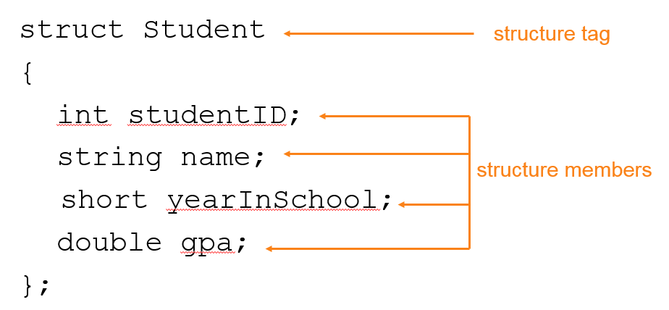
Example struct Declaration

Slide 7
struct Declaration
Must have ; after closing }
struct names commonly begin with uppercase letter
Multiple fields of same type can be in comma-separated list:
string name,
address;

Slide 8
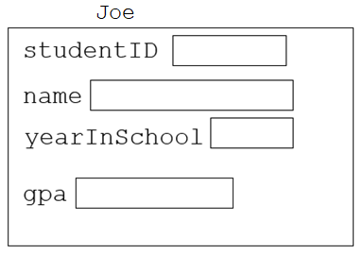
Defining Variables
struct declaration does not allocate memory or create variables
A variable is declared using the struct name:
Student Joe;

Slide 9
Initializing a Structure
struct variable can be initialized when defined:
Student Joe = {11465,"Joe Smith", 2, 3.75};
Can also be initialized member-by-member after definition:
Joe.name = "Joe Smith";
Joe.gpa = 3.75;
Dot . specifies the field

Slide 10
More on Initializing a Structure
May initialize only some members:
Student Joe = {14579};
Cannot skip over members:
Student s = {1234, "John", ,
2.83}; // illegal
Cannot initialize in the structure declaration, since this does not allocate memory

Slide 11
More on Initializing a Structure
Cannot initialize in the structure declaration, since this does not allocate memory
DOES NOT WORK:
struct X
{
int Y;
int Z;
}= {2,4}; // NOT ALLOWED
struct is creating a new type

Slide 12
Accessing Structure Members
Use the dot (.) operator to refer to members of struct variables:
cin >> Joe.studentID;
getline(cin, Joe.name);
Joe.gpa = 3.75;
Member variables can be used in any manner appropriate for their data type

Slide 13
Displaying a struct Variable
To display the contents of a struct variable, must display each field separately, using the dot operator:
cout << Joe; // won’t work
cout << Joe.studentID << endl;
cout << Joe.name << endl;
cout << Joe.yearInSchool;
cout << " " << Joe.gpa;

Slide 14
Comparing struct Variables
Cannot compare struct variables directly:
if (Joe == william) // won’t work
Instead, must compare on a field basis:
if (Joe.studentID ==
william.studentID) ...

Slide 15
Arrays of Structures
Structures can be defined in arrays
Can be used in place of parallel arrays const int NUM_STUDENTS = 20; Student studentList[NUM_STUDENTS];
Individual structures accessible using subscript notation
Fields within structures accessible using dot notation:
cout << studentList[5].studentID;

Slide 16
Nested Structures
A structure can contain another structure as a member:
struct PersonInfo
{ string name,
address,
city;
};
struct Student
{ int studentID;
PersonInfo pData;
short yearInSchool;
double gpa;
};

Slide 17
Members of Nested Structures
Use the dot operator multiple times to refer to fields of nested structures:
Student s;
s.pData.name = "Joanne";
s.pData.city = "Tulsa";

Slide 18
Structures as Function Arguments
May pass members of struct variables to functions:
computeGPA(Joe.gpa);

Slide 19
Structures as Function Arguments
May pass entire struct variables to functions:
showData(Joe);
void showData(Student s)
{
cout << s.pData.name << endl;
cout << s.pData.city << endl;
cout << s.studentID << endl;
cout << s. gpa << endl;
}

Slide 20
Structures as Function Arguments
May pass entire struct variables to functions, by value:
showData(Joe);
But this uses more space & is slow!
What can we do?

Slide 21
1. If values allowed to change
Pass by reference &
showData(Student &s);
Then, only a pointer to the structure is passed.
Less memory
Faster

Slide 22
2. const Reference
A new way to pass by ref, but forbid changes
const reference parameter
allows read-only access to reference parameter,
does not waste space
fast
showData(const Student &s); //prototype
Pointer to the structure is passed, but no changes allowed.

Slide 23
2. const Reference example
showData(const Student &s)
{
cout << s.pData.name << endl;
cout << s.pData.city << endl;
cout << s.studentID << endl;
cout << s. gpa << endl;
}
Joanne
Tulsa
1234
3.6

Slide 24
Returning a Structure from a Function
Function can return a struct:
Student getStudentData(); // prototype
Usage:
Student James;
James = getStudentData(); // call
Function must define a local struct
for internal use
for use with return statement

Slide 25
Returning a Structure from a Function - Example
Student getStudentData()
{ Student tempStu; // on stack
cin >> tempStu.studentID;
getline(cin, tempStu.pData.name);
getline(cin, tempStu.pData.address);
getline(cin, tempStu.pData.city);
cin >> tempStu.yearInSchool;
cin >> tempStu.gpa;
return tempStu;
}
But not very efficient. Why?
Copies the return value back to James upon return
In main:
Student James;
James = getStudentData();

Slide 26
Pointers to Structures
A structure variable has an address
Pointers to structures are variables that hold the address of a structure:
Student *studentPtr;
studentPtr = new Student;
Can use & operator to assign address:
studentPtr = & Joe;

Slide 27
Accessing Structure Members via Pointer Variables
Must use () to dereference pointer variable, not field within structure:
cout << (*studentPtr).studentID;
Can use structure pointer operator to eliminate () and use clearer notation:
cout << studentPtr->studentID;
‘Arrow’
-> means: star dot

Slide 28
3. For Efficient Functions pass pointers, not structs
Structure pointer can be a parameter
void getData(Student * sPtr);
Can also return a structure pointer
Student * getStudentData();
// (new Student created inside)

Slide 29
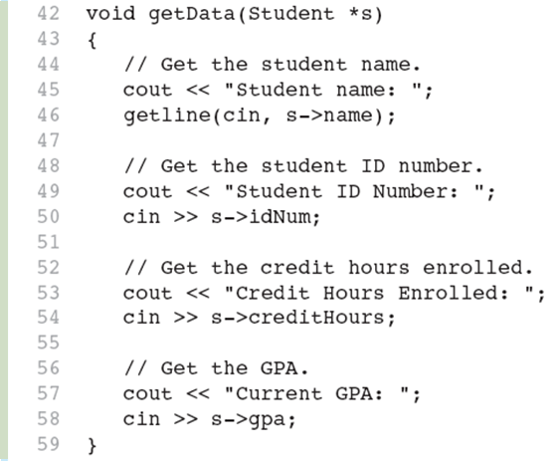
Example to fill data
Space is created OUTSIDE the function
Two use cases:
Student James;
getData(&James);
Student JamesPtr= new Student;
getData(JamesPtr);

Slide 30
How to create & fill – in one step?
Space is created INSIDE the function
and the pointer is
returned
Student * CreateAndFill()
{
Student *s = new Student; // s pts to space in heap
cout << "name:";
getline(cin, s->pData.name);
cout << "city:";
getline(cin, s->pData.city);
cout << "Student ID: ";
cin >> s->studentID;
cout << "gpa:";
cin >> s->gpa;
// etc.
return(s);
}
Use case:
Student *JamesPtr= CreateAndFill();
showData(*JamesPtr);
// if showData expects a struct
// then we need to use *JamesPtr to send it

Slide 31
Summary: struct
A custom type that you name
Contains declared data members or fields
Can be accessed in any order with the .
struct is public. Declared at top of file
As a parameter - most efficient to pass by ref or const ref

Slide 32
Summary: struct
Can create arrays of structs or ptr to struct
For ptr to struct, then access like this:
(*studentPtr).studentID
Equivalent ‘arrow’ -> ‘star dot’
(contents of ptr, then field)
studentPtr->studentID

Slide 33
Summary: For efficiency
Pass pointers to structs
Can create an instance inside or outside a function
Example:
Student *sPtr = new Student;
fillData(sPtr);
Access members with arrow ->
Example:
p->pData.name

Slide 34
Other Examples

Slide 35
Payroll Example
Struct and basic access

Slide 36
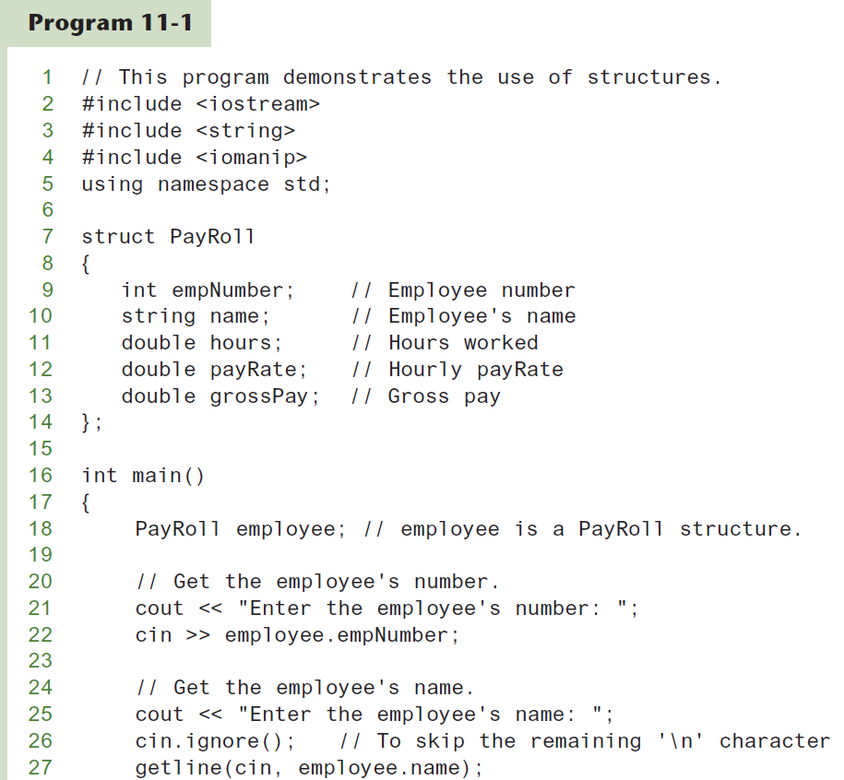

Slide 37
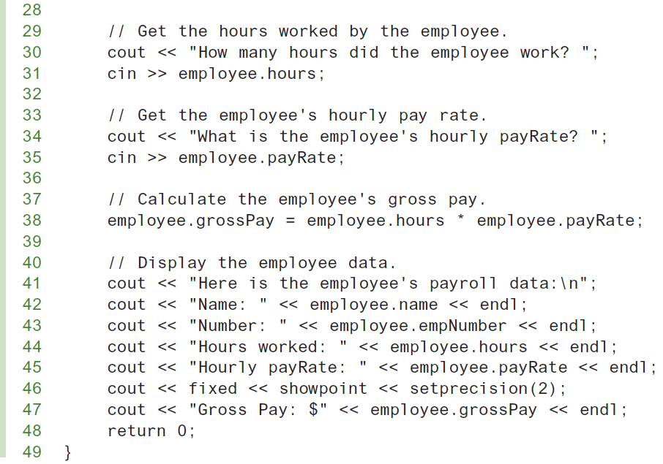

Slide 38
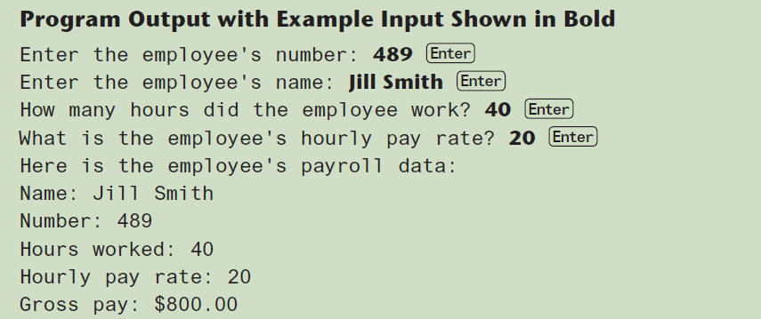

Slide 39
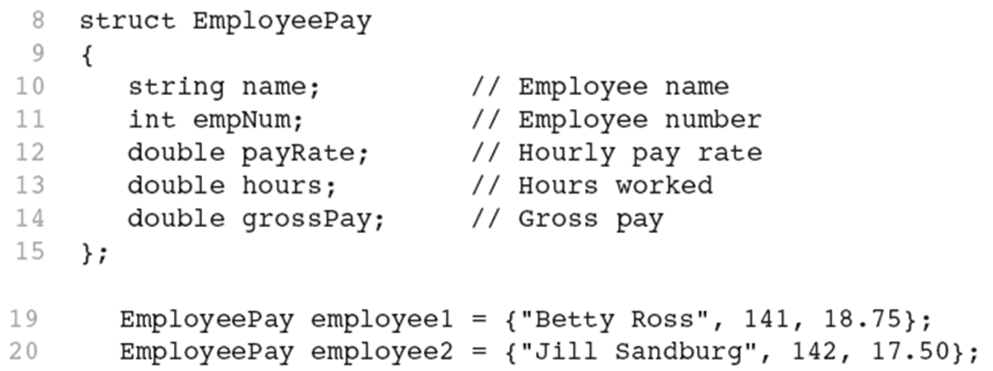
Initialization

Slide 40
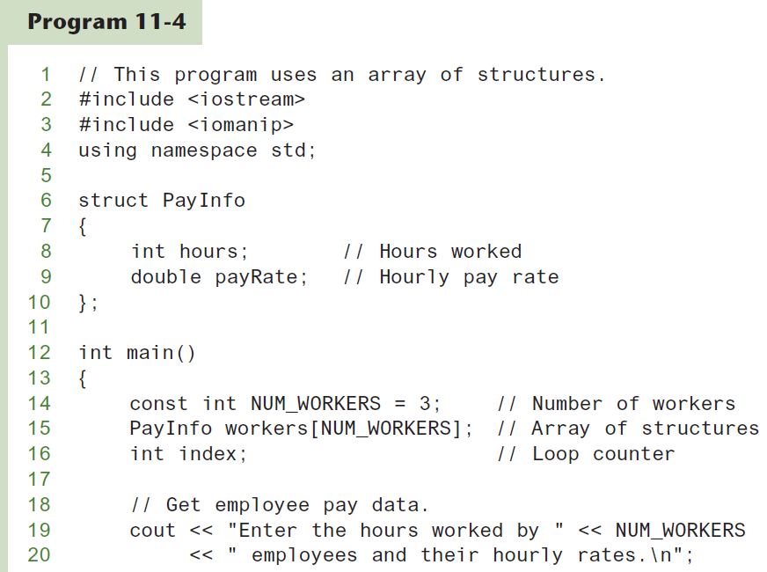
Example: Arrays of Structures

Slide 41
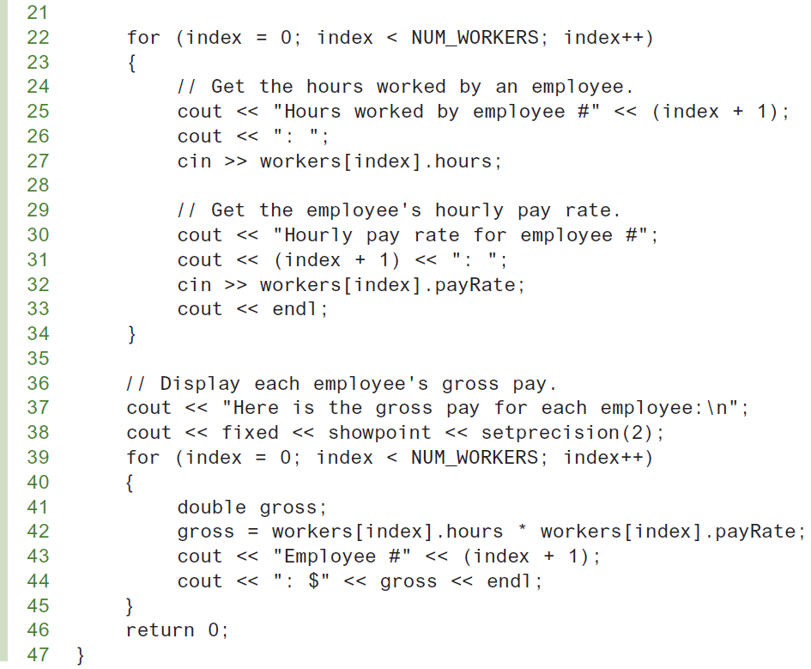

Slide 42
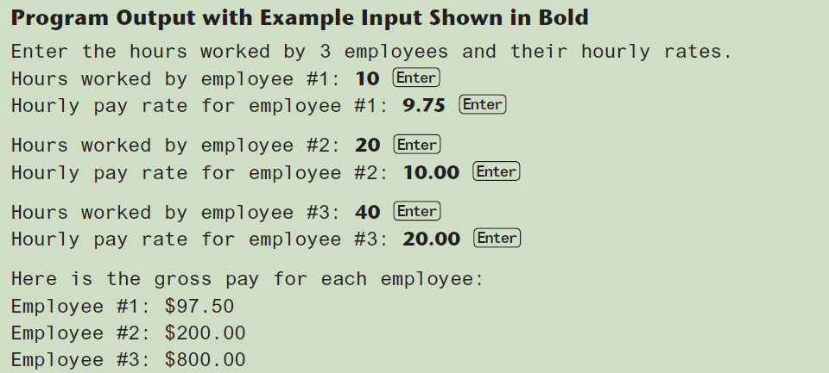

Slide 43
Circle Example
Returning a Structure from a Function

Slide 44
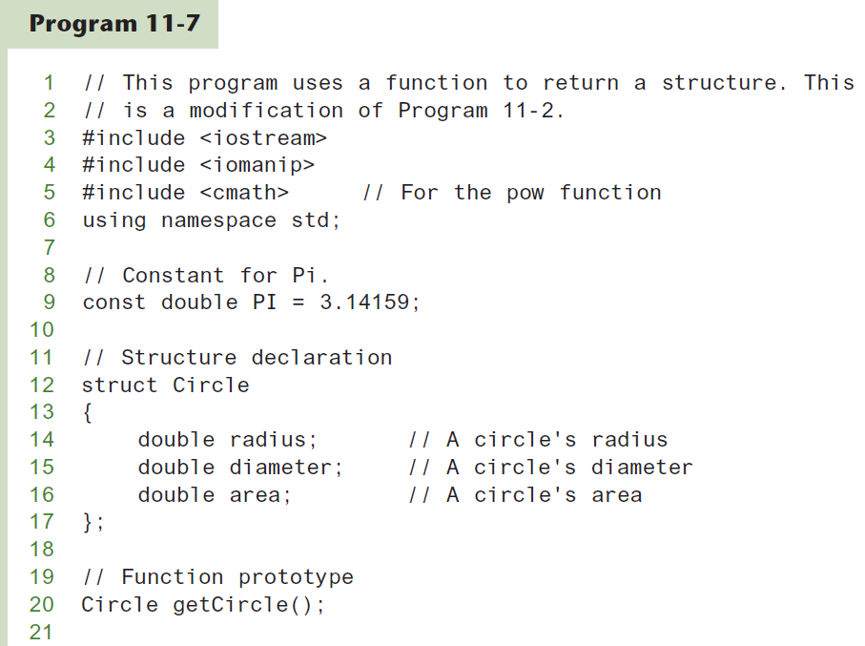

Slide 45
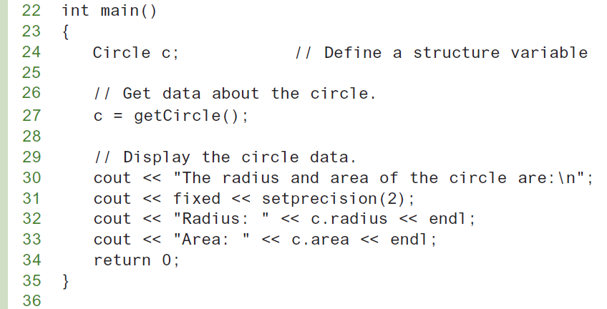

Slide 46
